Slide 1
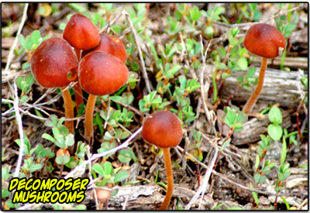
Topic 10
Fungi Kingdom
al-Farabi Ka akh National University
Faculty of Biology and biotechnology
Department of Biodiversity and Bioresources

Slide 2
Key Points
Fungi are more closely related to animals than plants.
Fungi are heterotrophic: they use complex organic compounds as sources of energy and carbon, not photosynthesis.
Fungi multiply either asexually, sexually, or both.
The majority of fungi produce spores, which are defined as haploid cells that can undergo mitosis to form multicellular, haploid individuals.
Fungi interact with other organisms by either forming beneficial or mutualistic associations (mycorrhizae and lichens ) or by causing serious infections.

Slide 3
Key Terms
Mycorrhiza: a symbiotic association between a fungus and the roots of a vascular plant
Lichen: any of many symbiotic organisms, being associations of fungi and algae; often found as white or yellow patches on old walls, etc.
Spore: a reproductive particle, usually a single cell, released by a fungus, alga, or plant that may germinate into another
Heterotrophic: organisms that use complex organic compounds as sources of energy and carbon
Saprophyte: any organism that lives on dead organic matter, as certain fungi and bacteria

Slide 4
Fungi, latin for mushroom, are eukaryotes which are responsible for decomposition and nutrient cycling through the environment.
Fungi Kingdom contains molds, mildews, rusts, smuts, yeasts, and mushrooms.
All fungi are multicellular except for yeast, which is unicellular. Most fungi are saprobes (live on dead and decaying organic matter) or parasitic (live in or on a host organism from which it takes nutrients)
All fungi are heterotrophic; they do not have chloroplasts
The saprobes are helpful because they break down organic material returning nutrients to the soil.
Yeasts are useful in the making of bread and fermented drinks.
Some parasitic fungi are actually human pathogens

Slide 5
Fungi Cell Structure and Function
Key Points
Fungal cell walls are rigid and contain complex polysaccharides called chitin (adds structural strength) and glucans.
Ergosterol is the steroid molecule in the cell membranes that replaces the cholesterol found in animal cell membranes.
Fungi in the morphological vegetative stage consist of a tangle of slender, thread-like hyphae, whereas the reproductive stage is usually more obvious.
Fungi like to be in a moist and slightly acidic environment; they can grow with or without light or oxygen.

Slide 6
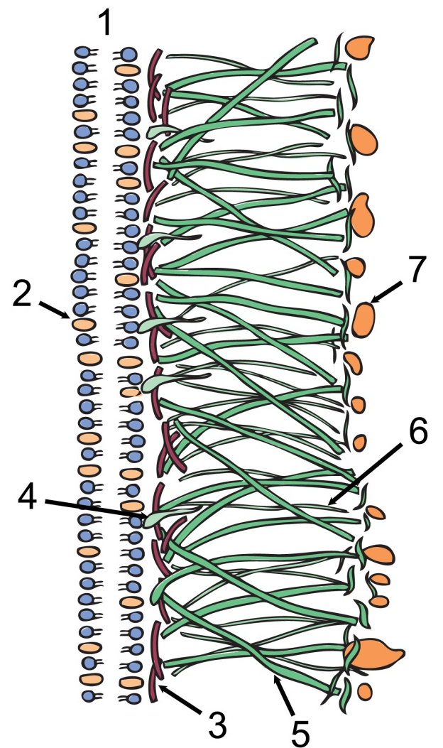
Both the structure and composition of the fungal cell wall have unique characteristics (Fig. 1). The rigid layers of fungal cell walls contain complex polysaccharides called chitin and glucans. Chitin, also found in the exoskeleton of insects, gives structural strength to the cell walls of fungi. The wall protects the cell from desiccation and predators.
Fungi have plasma membranes similar to other eukaryotes, except that the structure is stabilized by ergosterol: a steroid molecule that replaces the cholesterol found in animal cell membranes. Most members of the kingdom Fungi are nonmotile.
Fig 1 - Schematic structure of the cell membrane and cell wall fungi. 1: cell membrane; 2: ergosterol; 3: chitin; 4: anchore-proteins; 5: β(1,3) glucan; 6: β(1,6) glucan; 7: mannoproteins.

Slide 7
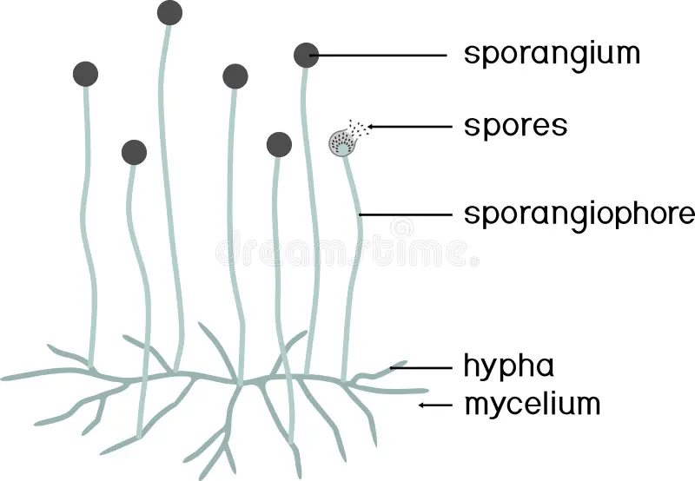
Key Terms
Mycelium: the vegetative part of any fungus, consisting of a mass of branching, threadlike hyphae, often underground
Hypha: a long, branching, filamentous structure of a fungus that is the main mode of vegetative growth
Septum: cell wall division between hyphae of a fungus
Thallus: vegetative body of a fungus
Chitin: a complex polysaccharide, found in the exoskeletons of arthropods and in the cell walls of fungi; thought to be responsible for some forms of asthma in humans

Slide 8
Structure of Fungi:
1. Hyphae - the vegetative filament, thin strands only one cell in thickness. Most hyphae have crosswalls that form cells and called septa. The non-septate hyphae are coenocytic, so one continuous hyphal segment may contain multitudes of nuclei. Then there are monokaryotic hyphae, when one nucleus is in one hyphal segment or the special dikaryotic hyphae when two nuclei are in one segment.
Hyphae have pores that allow most organelles to diffuse easily from one cell to the next as needed.
Septate hyphae
Coenocytic hyphae

Slide 9
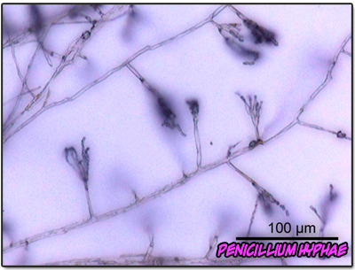
2. The fungi cell wall is made of chitin. This distinguishes fungi from plants, which have a cell wall made of cellulose. Within each cell is either one or two nuclei and other organelles.
3. Mycelium - a mat of interwoven hyphae. Allows large surface area to come in contact with food source making absorption easier; this is usually the visible body of the fungus and is also the structure involved in reproduction. The mushrooms are actually the mycelium of the fungus.

Slide 10


Slide 11
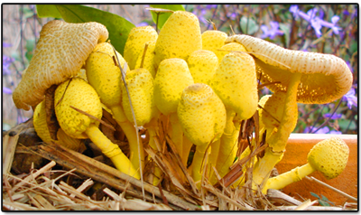
Reproduction
Fungi can reproduce vegetative by fragmentation, budding, asexually through producing spores, or sexually with homothallic or heterothallic mycelia.

Slide 12
Key Terms
Homothallic: male and female reproductive structures are present in the same plant or fungal mycelium
Spore: a reproductive particle, usually a single cell, released by a fungus, alga, or plant that may germinate into another
Sporangium: a case, capsule, or container in which spores are produced by an organism
Karyogamy: the fusion of two nuclei within a cell
Plasmogamy: stage of sexual reproduction joining the cytoplasm of two parent mycelia without the fusion of nuclei
Gametangium: an organ or cell in which gametes are produced that is found in many multicellular protists, algae, fungi, and the gametophytes of plants

Slide 13
Asexual Reproduction
Fungi reproduce asexually by fragmentation, budding, or producing spores. Fragments of hyphae can grow new colonies. Mycelial fragmentation occurs when a fungal mycelium separates into pieces with each component growing into a separate mycelium. Somatic cells in yeast form buds. During budding (a type of cytokinesis), a bulge forms on the side of the cell, the nucleus divides mitotically, and the bud ultimately detaches itself from the mother cell.
The most common mode of asexual reproduction is through the formation of asexual spores, which are produced by one parent only (through mitosis) and are genetically identical to that parent. Spores allow fungi to expand their distribution and colonize new environments. They may be released from the parent thallus, either outside or within a special reproductive sac called a sporangium.

Slide 14
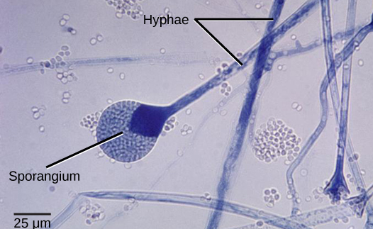
There are many types of asexual spores. Conidiospores are unicellular or multicellular spores that are released directly from the tip or side of the hypha. Other asexual spores originate in the fragmentation of a hypha to form single cells that are released as spores; some of these have a thick wall surrounding the fragment. Yet others bud off the vegetative parent cell. Sporangiospores are produced in a sporangium.
Release of spores from a sporangium: This micrograph shows the release of spores from a sporangium at the end of a hypha called a sporangiophore. The organism depicted is a Mucor sp. fungus: a mold often found indoors.

Slide 15
Asexual spores:
The fungus producing more than one type of spores is called the pleomorphic or polymorphic. The spores produced inside the sporangia are termed the endogenous spores and the spores developing exogenously on the terminal ends of sporophores are called the exogenous spores.
Endogenous spores:
The endogenous spores are produced within the special spore producing cell the sporangium. The sporangia may be terminal or intercalary in their position. The sporophores which bear the sporangia on their apices are called the sporangiophores. They may be branched or unbranched.
The spores produced inside the sporangia are called the endospores or endogenous. They may be motile or non-motile. The motile spores are called the zoospores and the non-motile aplanospores. The zoospores are produced inside the zoosporangia. The protoplasm of the sporangium divides into uninucleate or multinucleate protoplasmic bits and each bit metamorphoses into a spore.

Slide 16
Exogenous spores:
The spores producing externally or exogenously are either called the exogenous spores or conidia. They are produced externally on the branched or unbranched conidiophores. The conidiophores may be septate or aseptate. The conidia borne upon the terminal apices of the conidiophores or the ends of the branches of the conidiophores.
The conidia are diverse in their shape and size. They may be unicellular or multicellular, uninucleate or multinucleate. Different genera may be recognized only by the presence of various shaped and various coloured conidia. The conidia of Fungi Imperfecti are multicellular and variously shaped, whereas the conidia of Aspergillus and Penicillium are smoky green coloured and the fungi are called ‘the blue-green molds’.

Slide 17
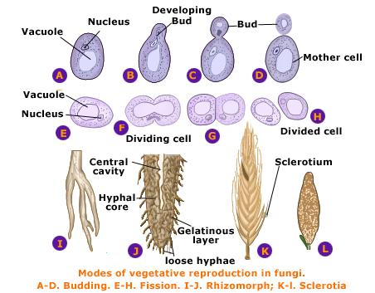
In addition to above-mentioned the fungi reproduce asexually by other means, such as fission, sclerotia, rhizomorphs, etc.
In fission, the cell constricts in the centre and divides into two giving rise to new individuals. The sclerotia are resistant and perennating bodies. They survive for many years. Each sclerotium is cushion-like structure of compact mycelium. They give rise to new mycelia on the approach of favourable conditions.
As mentioned under the modified mycelium, the rope-like rhizomorphs are also resistant to unfavorable conditions and give rise to new mycelia even after several years on the approach of favorable conditions.

Slide 18
Sexual Reproduction
In fungi, sexual reproduction often occurs in response to adverse environmental conditions. Two mating types are produced. When both mating types are present in the same mycelium, it is called homothallic, or self-fertile. Heterothallic mycelia require two different, but compatible, mycelia to reproduce sexually.
Although there are many variations in fungal sexual reproduction, all include the following three stages.
First, during plasmogamy (literally, “marriage or union of cytoplasm”),
two haploid cells fuse, leading to a dikaryotic stage where two haploid nuclei coexist in a single cell.

Slide 19
During karyogamy (“nuclear marriage”), the haploid nuclei fuse to form a diploid zygote nucleus.
Finally, meiosis takes place in the gametangia (singular, gametangium) organs, in which gametes of different mating types are generated. At this stage, spores are disseminated into the environment.
Each of the four divisions of fungi have different forms of sexual reproduction but most involve the production of spores in a specialized structure called a basidia in mushrooms, sporangium in bread mold, sac in Orange Cup fungi.

Slide 20
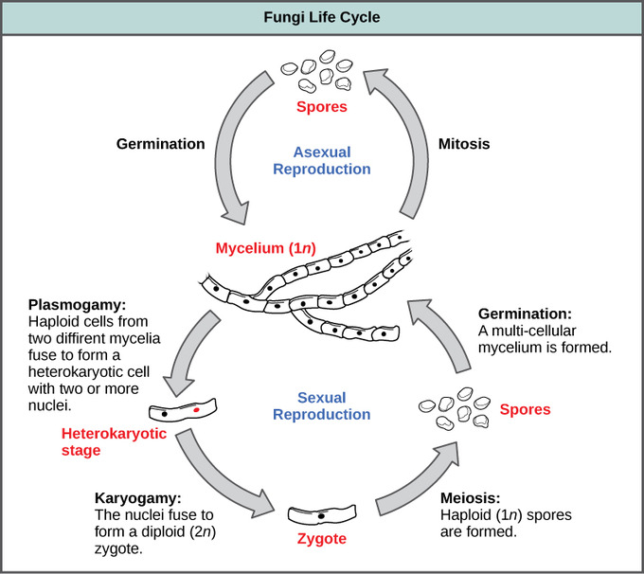
Types of fungal reproduction: Fungi may utilize both asexual and sexual stages of reproduction; sexual reproduction often occurs in response to adverse environmental conditions.

Slide 21
Fungi nutrition:
Saprophytic – The fungi obtain their nutrition by feeding on dead organic substances. Examples: Rhizopus, Penicillium and Aspergillus.
Parasitic – The fungi obtain their nutrition by living on other living organisms (plants or animals) and absorb nutrients from their host. Examples: Taphrina and Puccinia.
Symbiotic – These fungi live by having an interdependent relationship with other species in which both are mutually benefited. Examples: Lichens and mycorrhiza. Lichens are the symbiotic association between algae and fungi. Here both algae and fungi are mutually benefited as fungi provide shelter for algae and in reverse algae synthesis carbohydrates for fungi. Mycorrhiza is the symbiotic association present between fungi and plants. Fungi improve nutrient uptake by plants, whereas, plants provides organic molecules like sugar to the fungus.

Slide 22
Fungi also form a symbiotic (mutually beneficial) relationship with other organisms such as trees and flowering plants:
a. Ectomycorrhizal fungi grow thick coats of mycelia around the rootlets of trees and bring water and minerals from the soil into the roots. In return the host tree supplies the fungus with sugars, vitamins and other root substances. This relationship occurs in more than 80% of plants. Examples: the Bolete Family associated with many species of conifer trees, aspen and birch, and the "Dead Man's Foot" (Pisolithus tinctorius) which helps many plants grow.
b. Endomycorrhizal fungi are microscopic soil fungi that penetrate the cells of plant roots. This relationship may be beneficial to both parties or may be harmful to the plant.

Slide 23
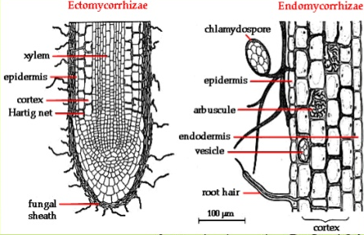
Fig. - Ectomycorrhizae and Endomycorrhizae

Slide 24
Classification of Fungi
The kingdom Fungi contains five major phyla that were established according to their mode of sexual reproduction or using molecular data.
The five true phyla of fungi are:
Chytridiomycota (Chytrids) - Flagellated zoospores and gametes;
Zygomycota (conjugated fungi) - Zygospore supported by suspensors on either side;
Ascomycota (sac fungi) - Ascospores born with asci;
Basidiomycota (club fungi) - Basidiospores born on sterigmata of basidia;
Deuteromycota - Sexual stage absent, reproduction by conidia born on conidiophores.

Slide 25
Chytridiomycota: The Chytrids
Chytrids are the most primitive group of fungi and the only group that possess gametes with flagella.
Key Points
The first recognizable chytrids appeared more than 500 million years ago during the late pre-Cambrian period.
Like protists, chytrids usually live in aquatic environments, but some species live on land.
Some chytrids are saprobes while others are parasites that may be harmful to amphibians and other animals.
Chytrids reproduce both sexually and asexually, which leads to the production of zoospores.
Chytrids have chitin in their cell walls; one unique group also has cellulose along with chitin.
Chytrids are mostly unicellular, but multicellular organisms do exist.

Slide 26
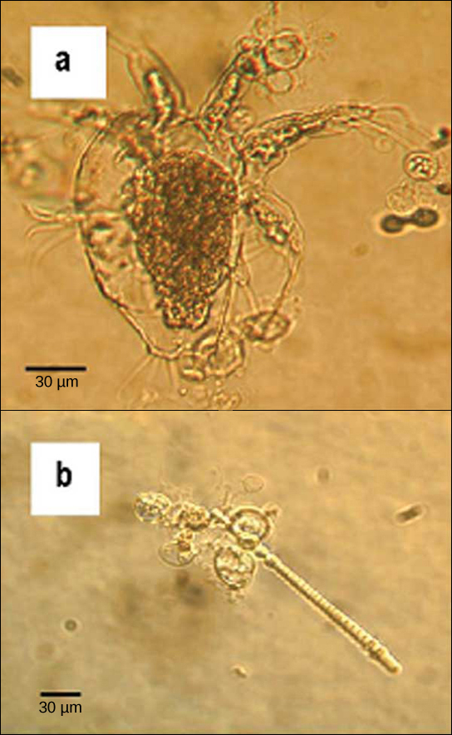
Parasitic chytrids: The chytrid Batrachochytrium dendrobatidis is seen in these micrographs as transparent spheres growing on (a) a freshwater arthropod and (b) algae.
This chytrid causes skin diseases in many species of amphibians, resulting in species decline and extinction.

Slide 27
Zygomycota: The Conjugated Fungi
Zygomycota, a small group in the fungi kingdom, can reproduce asexually or sexually, in a process called conjugation.
Key Points
Most zygomycota are saprobes, while a few species are parasites.
Zygomycota usually reproduce asexually by producing sporangiospores.
Zygomycota reproduce sexually when environmental conditions become unfavorable.
To reproduce sexually, two opposing mating strains must fuse or conjugate, thereby, sharing genetic content and creating zygospores.
The resulting diploid zygospores remain dormant and protected by thick coats until environmental conditions have improved.
When conditions become favorable, zygospores undergo meiosis to produce haploid spores, which will eventually grow into a new organism.

Slide 28
Zygomycota
Common bread mold & many soil fungi
Hyphae lack septa
The zygomycetes are a relatively small group in the fungi kingdom and belong to the Phylum Zygomycota. They include the familiar bread mold, Rhizopus stolonifer, which rapidly propagates on the surfaces of breads, fruits, and vegetables.
They are mostly terrestrial in habitat, living in soil or on plants and animals. Most species are saprobes meaning they live off decaying organic material.
Some are parasites of plants, insects, and small animals, while others form symbiotic relationships with plants. Zygomycetes play a considerable commercial role.
The metabolic products of other species of Rhizopus are intermediates in the synthesis of semi-synthetic steroid hormones.

Slide 29
Zygomycetes have a thallus of coenocytic hyphae in which the nuclei are haploid when the organism is in the vegetative stage. The fungi usually reproduce asexually by producing sporangiospores. The black tips of bread mold, Rhizopus stolonifer, are the swollen sporangia packed with black spores. When spores land on a suitable substrate, they germinate and produce a new mycelium.

Slide 30
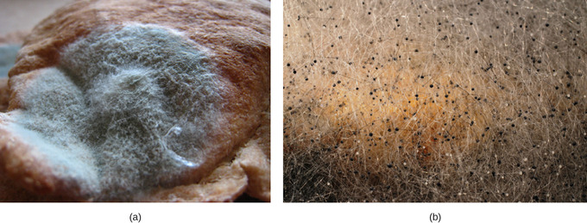
Sporangia of bread mold: Sporangia grow at the end of stalks, which appear as
(a) white fuzz seen on this bread mold, Rhizopus stolonifer.
The (b) tips of bread mold are the spore-containing sporangia.

Slide 31
Sexual reproduction starts when conditions become unfavorable. Two opposing mating strains (type + and type –) must be in close proximity for gametangia (singular: gametangium) from the hyphae to be produced and fuse, leading to karyogamy. The developing diploid zygospores have thick coats that protect them from desiccation and other hazards. They may remain dormant until environmental conditions become favorable.
When the zygospore germinates, it undergoes meiosis and produces haploid spores, which will, in turn, grow into a new organism. This form of sexual reproduction in fungi is called conjugation (although it differs markedly from conjugation in bacteria and protists), giving rise to the name “conjugated fungi”.

Slide 32
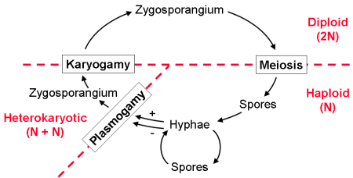
Zygomycete life cycle: Zygomycetes have asexual and sexual life cycles. In the sexual life cycle, plus and minus mating types conjugate to form a zygosporangium.

Slide 33
Ascomycota: also known as 'sac fungi‘
Most fungi belong to the Phylum Ascomycota, which uniquely forms of an ascus, a sac-like structure that contains haploid ascospores.
The sac fungi, or Ascomycetes, are a monophyletic group of fungi, which account for approximately 75% of all described fungi, including many of the known molds and yeasts, as well as the beloved morels and truffles: Saccharomyces cerevisiae, the yeast of the baking and brewing industries, Penicillium chrysogenum, producer of penicillin, and Morchella esculentum, the edible morel.

Slide 34
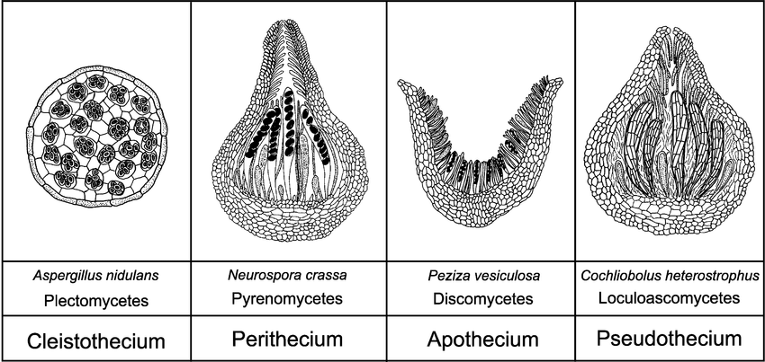
The fruiting body is known as ascocarp. There are four types of ascocarps:
  Cleistothecium- The fruiting body is spherical and remains tightly closed, e.g. Aspergillus
  Perithecium- The fruiting body is flask-shaped with one external opening, e.g. Neurospora
  Apothecium- The fruiting body is cup-shaped and asci are present in hymenium, e.g. Peziza
  Ascostroma- There is no differentiated fruiting body. Asci are present in the stroma, e.g. Mycosphaerella

Slide 35
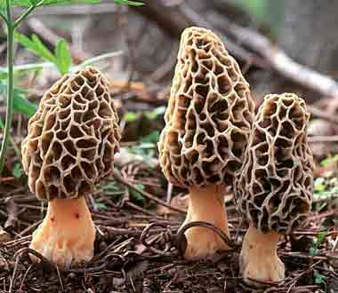
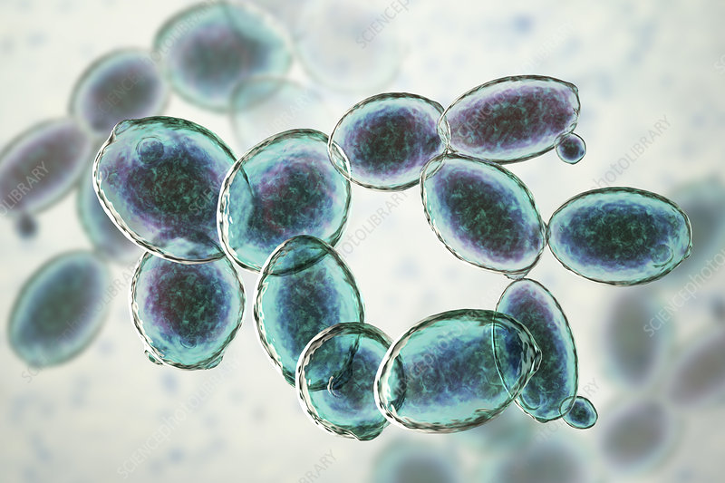
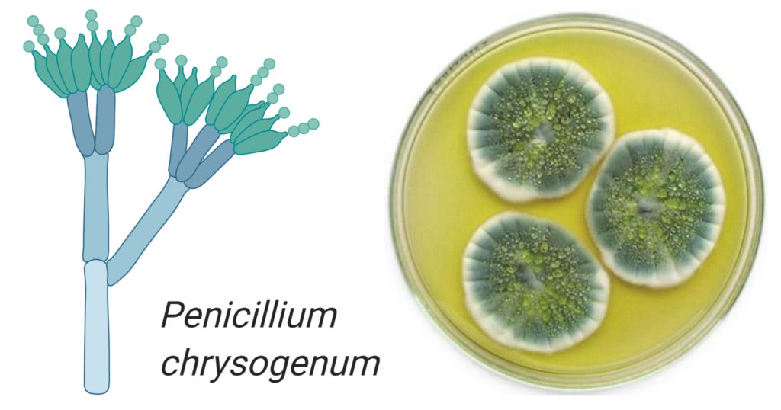
Saccharomyces cerevisiae
Morchella esculentum

Slide 36
Key Points
Ascomycota fungi are the yeasts used in baking, brewing, and wine fermentation, plus delicacies such as truffles and morels.
Ascomycetes are filamentous and produce hyphae divided by perforated septa.
Ascomycetes frequently reproduce asexually which leads to the production of conidiophores that release haploid conidiospores.
Two types of mating strains, a “male” strain which produces an antheridium and a “female” strain which develops an ascogonium, are required for sexual reproduction.
The antheridium and the ascogonium combine in plasmogamy at the time of fertilization, followed by nuclei fusion in the asci.
In the ascocarp, a fruiting body, thousands of asci undergo meiosis to generate haploid ascospores ready to be released to the world.

Slide 37
Conidia: asexual, non-motile spores of a fungus, named after the Greek word for dust, conia; also known as conidiospores and mitospores
Antheridia: a haploid structure or organ producing and containing male gametes (called antherozoids or sperm) present in lower plants like mosses and ferns, primitive vascular psilotophytes, and fungi
Ascogonium: a haploid structure or organ producing and containing female gametes in certain Ascomycota fungi
Ascocarp: the sporocarp of an ascomycete, typically bowl-shaped
Ascomycete: any fungus of the phylum Ascomycota, characterized by the production of a sac, or ascus, which contains non-motile spores

Slide 38
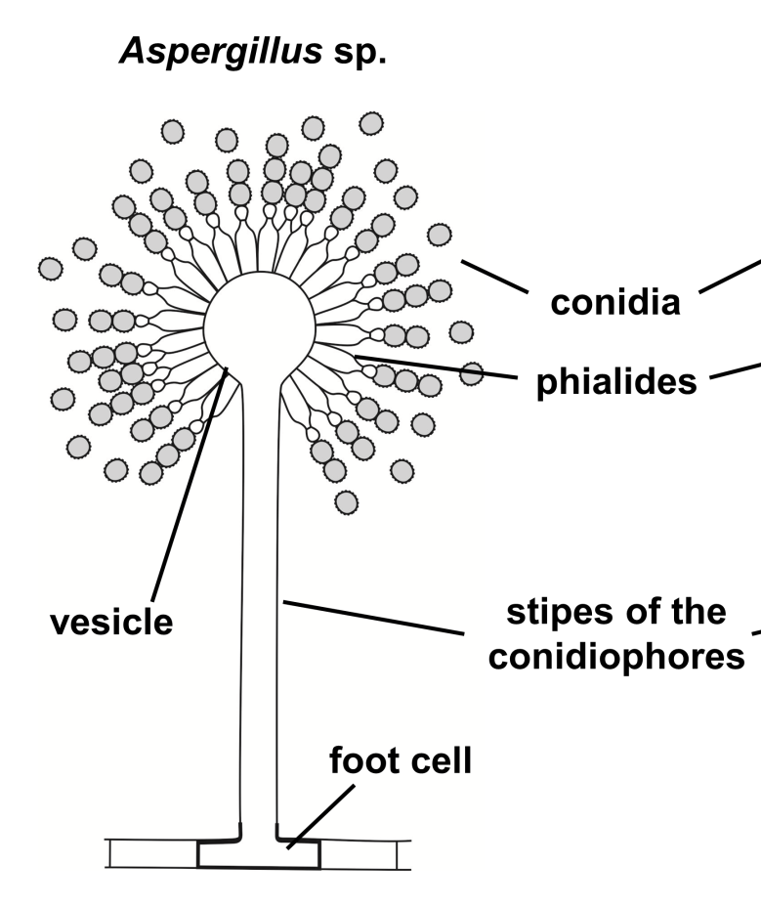
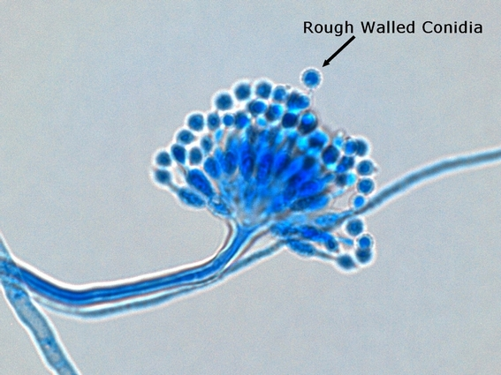
Asexual reproduction is frequent and involves the production of conidiophores that release haploid conidiospores. Unlike the Zygomycetes which produce asexual spores within sporangia, conidia are produced on the ends of specialized hyphae called conidiophores.
Aspergillus

Slide 39
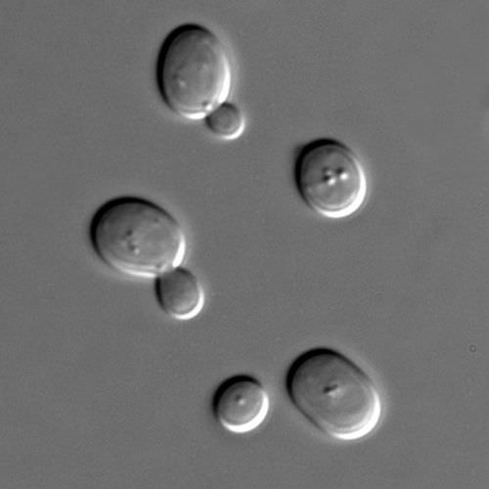
Yeasts do not produce spores. Instead, they reproduce asexually by budding (Fig.1).
A small bud, or daughter cell, is formed on the parent cell. The nucleus of the parent cell splits into a daughter nucleus and migrates into the daughter cell. The bud continues to grow until it separates from the parent cell, forming a new cell. The bud can develop on different parts of the parent cell, depending on the genus of the yeast.
Fig.1. Yeasts such as Saccharomyces cerevisiae reproduce asexually by budding.

Slide 40
Sexual reproduction starts with the development of special hyphae from either one of two types of mating strains. The “male” strain produces an antheridium (plural: antheridia) and the “female” strain develops an ascogonium (plural: ascogonia).
At fertilization, the antheridium and the ascogonium combine in plasmogamy without nuclear fusion. Special ascogenous hyphae arise, in which pairs of nuclei migrate: one from the “male” strain and one from the “female” strain. In each ascus, two or more haploid ascospores fuse their nuclei in karyogamy.
During sexual reproduction, thousands of asci fill a fruiting body called the ascocarp. The diploid nucleus gives rise to haploid nuclei by meiosis. The ascospores are then released, germinate, and form hyphae that are disseminated in the environment and start new mycelia.

Slide 41
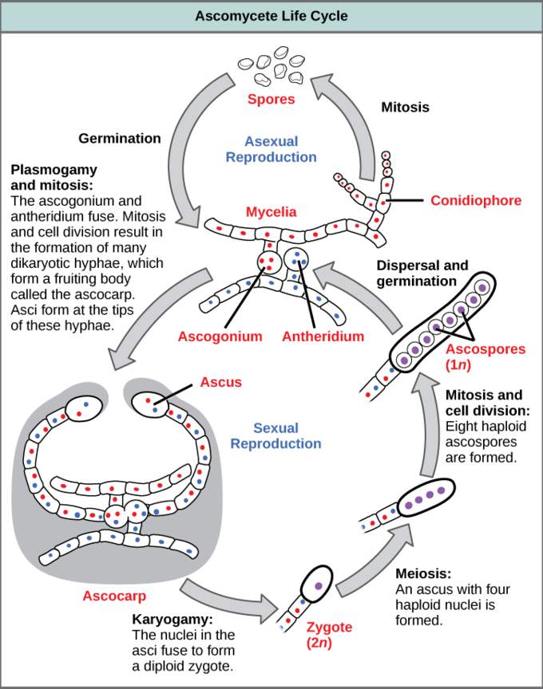
Fig. 3. Ascomycete Life Cycle. The lifecycle of an ascomycete is characterized by the production of asci during the sexual phase. The haploid phase is the predominant phase of the life cycle.

Slide 42
Basidiomycota: The Club Fungi
Basidium means 'little pedestal' which is what a mushroom looks like.
Key Points
The majority of edible fungi belong to the Phylum Basidiomycota.
The basidiomycota includes shelf fungus, toadstools, and smuts and rusts.
Unlike most fungi, basidiomycota reproduce sexually as opposed to asexually.
Two different mating strains are required for the fusion of genetic material in the basidium which is followed by meiosis producing haploid basidiospores.
Mycelia of different mating strains combine to produce a secondary mycelium that contains haploid basidiospores in what is called the dikaryotic stage, where the fungi remains until a basidiocarp (mushroom) is generated with the developing basidia on the gills under its cap.

Slide 43
Key Terms
Basidiocarp: a fruiting body that protrudes from the ground, known as a mushroom, which has a developing basidia on the gills under its cap
Basidiomycete: a fungus of the phylum Basidiomycota, which produces sexual spores on a basidium
Basidiomycota: a taxonomic division within the kingdom Fungi: 30,000 species of fungi that produce spores from a basidium
Basidium: a small structure, shaped like a club, found in the Basidiomycota phylum of fungi, that bears four spores at the tips of small projections
Basidiospore: a sexually-reproductive spore produced by fungi of the phylum Basidiomycota

Slide 44
The fungi in the Phylum Basidiomycota are easily recognizable under a light microscope by their club-shaped fruiting bodies called basidia (singular, basidium), which are the swollen terminal cell of a hypha. The basidia, which are the reproductive organs of these fungi, are often contained within the familiar mushroom, commonly seen in fields after rain, on the supermarket shelves, and growing on your lawn.
These mushroom-producing basidiomyces are sometimes referred to as “gill fungi” because of the presence of gill-like structures on the underside of the cap. The “gills” are actually compacted hyphae on which the basidia are borne. This group also includes shelf fungus, which cling to the bark of trees like small shelves. In addition, the basidiomycota includes smuts and rusts, which are important plant pathogens, and toadstools. Most edible fungi belong to the Phylum Basidiomycota; however, some basidiomycetes produce deadly toxins. For example, Cryptococcus neoformans causes severe respiratory illness.

Slide 45
Reproduction
Asexual reproduction in club fungi is rare.
The lifecycle of basidiomycetes includes alternation of generations. Spores are generally produced through sexual reproduction, rather than asexual reproduction. The club-shaped basidium carries spores called basidiospores. In the basidium, nuclei of two different mating strains fuse (karyogamy), giving rise to a diploid zygote that then undergoes meiosis. The haploid nuclei migrate into basidiospores, which germinate and generate monokaryotic hyphae. The mycelium that results is called a primary mycelium.
Mycelia of different mating strains can combine and produce a secondary mycelium that contains haploid nuclei of two different mating strains. This is the dikaryotic stage of the basidiomyces lifecyle and it is the dominant stage. Eventually, the secondary mycelium generates a basidiocarp, which is a fruiting body that protrudes from the ground; this is what we think of as a mushroom. The basidiocarp bears the developing basidia on the gills under its cap.

Slide 46
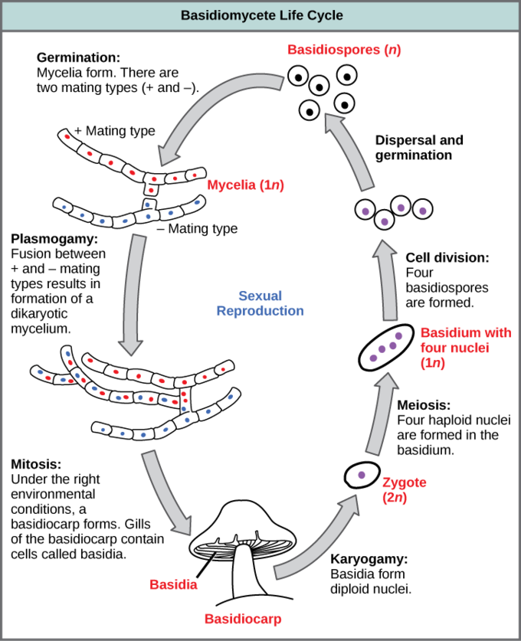

Slide 47
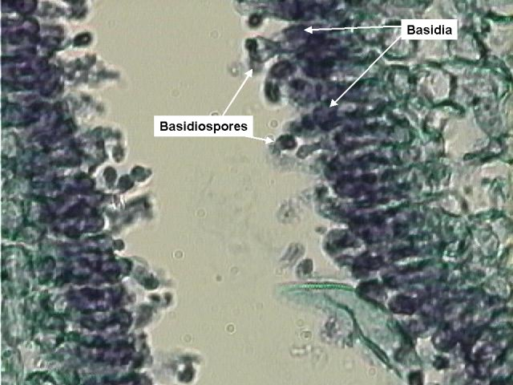
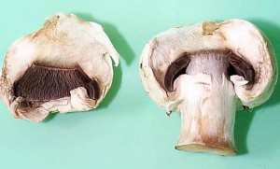
Their fruiting bodies are called basidiocarps. This is the visible mushroom.
Spores, called basidiospores are produced on basidia within the basidiocarps. In mushrooms, the basidia are located along the gills on the underside of the cap. In figure, a portion of the cap of this mushroom has been broken away to reveal the gills. In basidiomycota, the basidiospores are not enclosed.
Mushrooms showing gills

Slide 48
Divisions Basidiomycota
Class Teliobasidiomycetcetes
Order Uredinales
Puccinia graminis (stem rust) .
The stem, black, and cereal rusts are caused by the fungus Puccinia graminis and are a significant disease affecting cereal crops. Crop species that are affected by the disease include bread wheat, durum wheat, barley and triticale. Different from most fungi, the rust variations have five spore stages and alternate between two hosts. Wheat is the primary host, and barberry is the alternate host.
In Puccinia graminis, the species that will be used as the representative for this order, there are five spore stages that are produced and two hosts are required in the completion of the life cycle. The five stages produced are:
Stage 0: Spermagonium
Stage I: Aecium
Stage II: Uredium
Stage III: Telium
Stage IV: Basidium

Slide 49
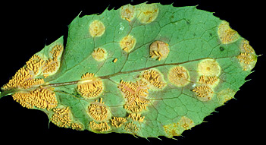
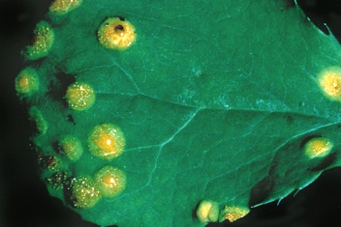
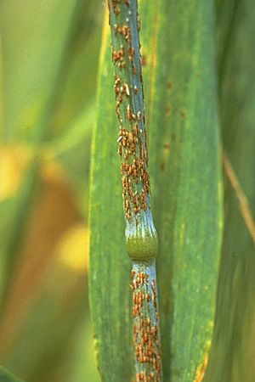
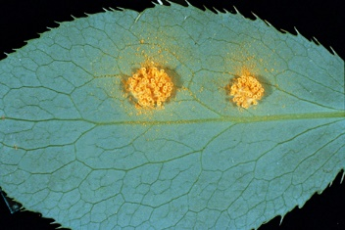
Powdery aeciospores on the lower leaf surface
Pycniospores in a sticky honeydew
The aecial cups are yellow and sometimes elongate to extend up to 5 mm from the leaf surface
Uredinia of Puccinia graminis

Slide 50
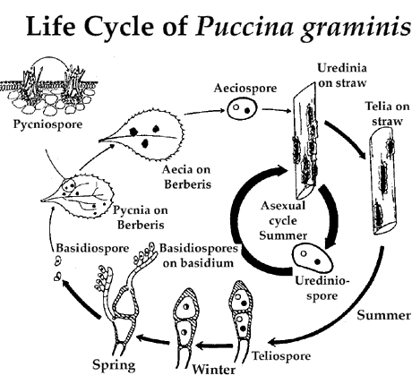

Slide 51
Deuteromycota: also known as 'imperfect fungi'
Phylum Deuteromycota is a polyphyletic group of asexually-reproducing fungi that do not display a sexual phase; they are known as imperfect.
Key Points
Deuteromycota do not possess the sexual structures that are used to classify other fungi.
Most deuteromycota live on land; they form visible mycelia with a fuzzy appearance called mold.
Recombination of genetic material is known to take place between the different nuclei after some hyphae recombine.

Slide 52
Key Terms
deuteromycete: an organism of the phylum Deuteromycota
Deuteromycota: a taxonomic morphological group within the kingdom Fungi; the fungi have no sexual reproduction
polyphyletic: having multiple ancestral sources; referring to a taxon that does not contain the most recent common ancestor of its members
conidiospore: a unicellular spore produced asexually by a fungus

Slide 53
Imperfect fungi are those that do not display a sexual phase. They are classified as belonging to the form Phylum Deuteromycota. Deuteromycota is a polyphyletic group where many species are more closely related to organisms in other phyla than to each other; hence it cannot be called a true phylum and must, instead, be given the name form phylum. Since they do not possess the sexual structures that are used to classify other fungi, they are less well described in comparison to other divisions.
Most members live on land, with a few aquatic exceptions. They form visible mycelia with a fuzzy appearance and are commonly known as mold. Molecular analysis shows that the closest group to the deuteromycetes is the ascomycetes. In fact, some species, such as Aspergillus, which were once classified as imperfect fungi, are now classified as ascomycetes..
Reproduction of Deuteromycota is strictly asexual, occuring mainly by production of asexual conidiospores. Some hyphae may recombine and form heterokaryotic hyphae. Genetic recombination is known to take place between the different nuclei.

Slide 54
Oomycetes (water molds)
The oomycetes, also known as “water molds”, are a group of several hundred organisms that include some of the most devastating plant pathogens. The diseases they cause include seedling blights, damping-off, root rots, foliar blights and downy mildews. Some notable diseases are the late blight of potato, downy mildew of grape vine, sudden oak death, and root and stem rot of soybean.
"Oomycota" means "egg fungi," and refers to the large round oogonia, or structures containing the female gametes. Oomycetes are oogamous, producing large non-motile gametes called eggs, and smaller gametes called sperm.

Slide 55
Oomycetes were once classified as fungi because their body and behaviour have similarities to these organisms. They grow as branching filaments known as hyphae, as fungi do. They also absorb nutrients through the walls of the hyphae and reproduce by spores. Biologists have discovered that there are some important differences between oomycetes and fungi, however.
The cell wall of oomycetes, however, is not composed of chitin, as in the fungi, but is made up of a mix of cellulosic compounds and glycan. The nuclei within the filaments are diploid, with two sets of genetic information, not haploid as in the fungi.

Slide 56
Lichens
Lichens: a combination of two organisms
Lichens are not a single organism, but, rather, an example of a mutualism in which a fungus (usually a member of the Ascomycota or Basidiomycota phyla) lives in close contact with a photosynthetic organism (a eukaryotic alga or a prokaryotic cyanobacterium).
The body of a lichen, referred to as a thallus, is formed of hyphae wrapped around the photosynthetic partner. The photosynthetic organism provides carbon and energy in the form of carbohydrates. Some cyanobacteria fix nitrogen from the atmosphere, contributing nitrogenous compounds to the association. In return, the fungus supplies minerals and protection from dryness and excessive light by encasing the algae in its mycelium. The fungus also attaches the symbiotic organism to the substrate.

Slide 57
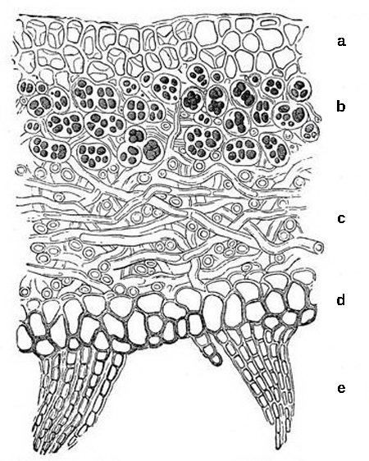
Generally, most of a lichen's bulk is made of interwoven fungal filaments. The fungus is called a mycobiont. The photosynthesizing organism is called a photobiont. Algal photobionts are called phycobionts. Cyanobacteria photobionts are called cyanobionts.
Thallus of lichen: This cross-section of a lichen thallus shows the
upper cortex of fungal hyphae, which provides protection;
(b) algal zone where photosynthesis occurs,
(c) medulla of fungal hyphae,
d) lower cortex, which also provides protection and may have
(e) rhizines to anchor the thallus to the substrate.

Slide 58
Lichens can live on rocks because they secrete enzymes that break rock down into soil; for this reason lichens are frequently the 'pioneer organisms in creating new ecosystems on newly formed or bare rock.
Lichens are very sensitive to the atmosphere and need clean, unpolluted air.
The thallus of lichens grows very slowly, expanding its diameter a few millimeters per year. Both the fungus and the alga participate in the formation of dispersal units for reproduction.

Slide 59
Lichens commonly reproduce by simple fragmentation, by the production of special powdery propagules known as soredia, or by small outgrowths known as isidia. Fragments, soredia, and isidia, which all contain both fungal hyphae and algae or cyanobacteria, act as small dispersal units to establish the lichen in new localities. The fungal component of the lichen produces ascospores, conidia, or basidiospores that are typical of its taxonomic group. If the fungus is an ascomycete, it may form ascomata, which are similar to those of other ascomycetes except that, in lichens, the ascomata may endure and produce spores slowly but continuously over a number of years. Regardless of the type of spore, any of them may form new lichens when they germinate and come into contact with the appropriate green algae or cyanobacteria.

Slide 60
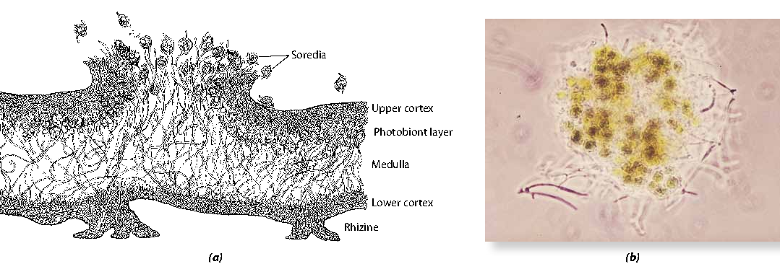
Fig. A stratified lichen (a) A cross section of the lichen Lobaria verrucosa, shown here releasing soredia consisting of hyphae wrapped around cyanobacteria. There are four distinct layers: (1) the upper cortex, a protective surface of heavily gelatinized fungal hyphae; (2) the photobiont layer, which, in Lobaria, consists of cyanobacterial cells and loosely interwoven, thin-walled hyphae; (3) the medulla, consisting of loosely packed, weakly gelatinized hyphae, which makes up about twothirds of the thickness of the thallus and appears to serve as a storage area; and (4) the lower cortex, which is thinner than the upper cortex and is covered with fine projections (rhizines) that attach the lichen to its substrate. (b) A soredium, composed of fungal hyphae and cells of the photobiont.

